Slide 1
PAINTING FROM PART
Iulia Popa
Dongsheng Guo, Haoru Zhao, Yunhao Cheng, Haiyong Zheng, Zhaorui Gu, Bing Zheng

Slide 2
CONTENTS
Part-painting
Problem and solution
01
Phases of Part-Painting
02
Related Work
03
Brief description of part-painting
Part-noise Restarting
Part-feature Repainting
Part-patch Refining
Inpainting & Outpainting
Generative Adversarial Networks
Wavelet-based Generation Network
Image-to-Image Translation

Slide 3
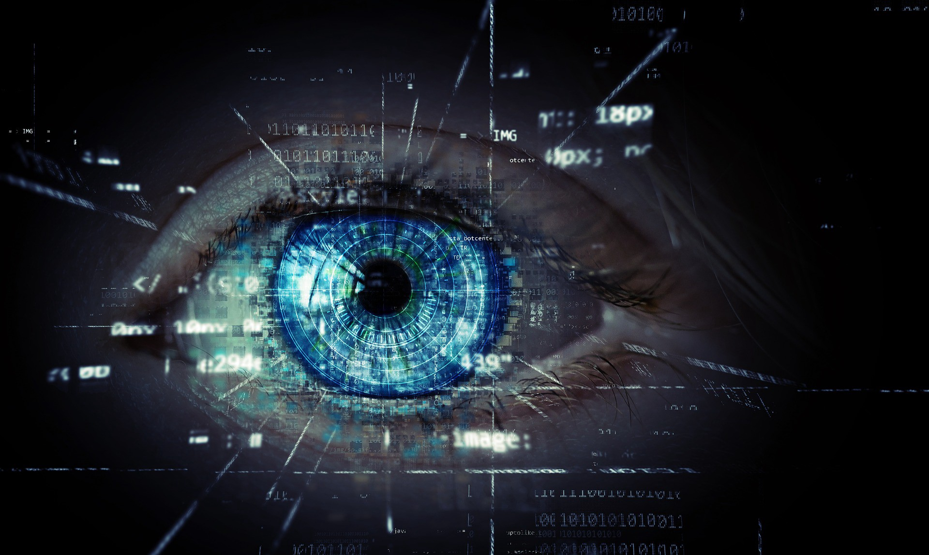
INTRODUCTION
Painting from Part (Part-painting for short) represents the procedure of painting the complete image from a part of it, using a simple human ability: given a region of a picture, people can visualize the unseen rest of the image.
INTRO
Notes:
Abilitatea omului de a vedea o imagine completa, primind initial doar o parte din ea;

Slide 4
01
Part-painting
Problem and solution
The connection between part and whole

Slide 5
Painting from Part problem
- real life applicability -
Computer Science
Visual Arts
Computer vision
Texture analysis
Image-editing
Video games
Generated media
Abstract art
Comics
Animated movies
Cartoons
Books
Notes:
Aplicabilitate in viata reala: in programare/computer science si arte vizuale;
Nevoia de a gasi particularitati din domeniul local (bucata primita la intrare) si cel global (alte imagini similare) pentru a crea corespondenta intre cele doua;

Slide 6
Painting from Part solution
Ability to generate complete images
from irregular shaped parts
Utilization of the given part, a mask
and random noise from a standard
normal distribution
Novel network architecture based
On Generative Adversarial Networks
Notes:
Ce ii diferentiaza de alte proiecte? Abordarea aceasta are capacitatea de a obtine imagini intregi, primind ca input chiar si parti cu forme neregulate, in timp ce ceilalti oameni de stiinta foloseau majoritar regiuni patratice initiale.
In plus, ei folosesc procedee ce implica existenta unei masti si a unei functii de zgomot din distributia Gauss.
Au creat o arhitectura de retea noua bazata pe Generative Adversarial Networks (Retele contradictorii generative - cringe). -> pe scurt, modalitate de abordare a modelarii generative prin metode de machine laearning, in special prin retele neuronale convolutionale (CNNs)

Slide 7
Phases of Part-Painting
02

Slide 8
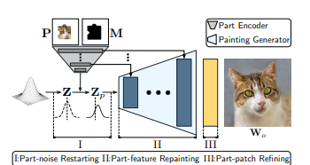
Steps of the process
Part-noise
Restarting
Part-feature Repainting
Part-patch Refining
The system is restarted in the beginning in order to adjust normally distributed part-noise.
The process repaints the generated characteristics using feature transferring methods.
The application makes the resulted image clearer by connecting the similar parts.
Notes:
La inceput, este nevoie de restartarea sistemului pentru a modifica parametral distributia normala a zgomotului produs de partea primita la intrare
Sistemul reproduce caracteristicile generate folosind metode de transfer a aspectelor cunoscute
La final, aplicatia ajusteaza imaginea rezultata pentru a o face clara si realista

Slide 9
Part-noise Restarting
Painting from noise instead of straight painting from given part
Utilizing the Hadamard product in formula
Using the normal distribution of the local domain (input component)
Constructing distributions for each image for painting improvement
Reviewing the noise with the specifical encoder
Notes:
GANs - rol esential in reprezentarea si generarea imaginilor
Incep prin desenarea folosind zgomotul, ci nu direct partea data
Folosesc repetat procedeul folosind acest zgomot, prin utilizarea distributiei Gauss a domeniului local, adica a componentei de intrare
Analizeaza zgomotul cu anumiti parametri specifici dati de codificator
Folosesc o formula ce include produsul Hadamard pentru matrice -> aduce eficienta si acuratete calculului
Ajuta la evolutia imaginii prin constructia distributiilor pentru fiecare imagine in parte

Slide 10
Part-feature Repainting
Imitating the human’s ability to complete a region by adding unseen elements
Transferring procedures
Using a novel component, called Repainting Residual Block (RRB)
Reconstructing the whole-feature with convolutional methods
Processing each layer, maintaing a strong connection between them
Notes:
Incearca sa mimeze capacitatea omului de a vedea intreaga imagine, desi nu detine toate partile din ea
Folosesc o componenta noua, creata de ei, numita RRB care are rolul de a produce ultimul bloc al fiecarui nivel specific: primeste whole-feature de la step 1, extrage informatiile din aceasta, produce desenul folosind acele detalii, repeta procedeul pentru toate blocurile din fiecare nivel al imaginii
Astfel, pastreaza in permanenta o relatie intre niveluri
Echilibrul se mentine prin metode de trasnfer, concatenare, separare si combinare
Reconstructia caracteristicilor intregului se realizeaza prin metode convolutionale care integreaza parametrii in legatura cu fiecare aspect cunoscut

Slide 11
Part-patch Refining
Adjusting the whole-feature
Whole-patch fusioning
Changing parts in pixels
Returning the complete image as a result
Part-patch transmitting
Notes:
Recicleaza caracteristicile piesei initiale pentru a finisa imaginea returnata -> ajusteaza corespunzator whole-feature
Transforma partile compozitionale in pixeli
Pixelii obtinuti iau locul regiunii reproduse la pasiul anterior = Part-patch transmitting
Procedeul poate fi dificil daca existe diferente mari intre partea cunoscuta si cea necunoscuta -> de aceea combina partile transmise anterior cu cele redesenate in procesul de whole-patch fusioning
Returneaza imaginea finala finisata

Slide 12

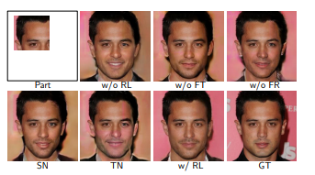
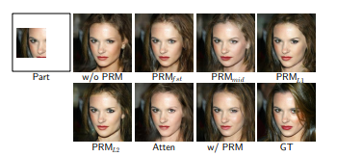


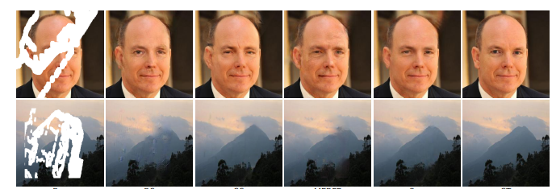
A PICTURE IS A WORTH A THOUSAND WORDS

Slide 13
03
Related Work

Slide 14
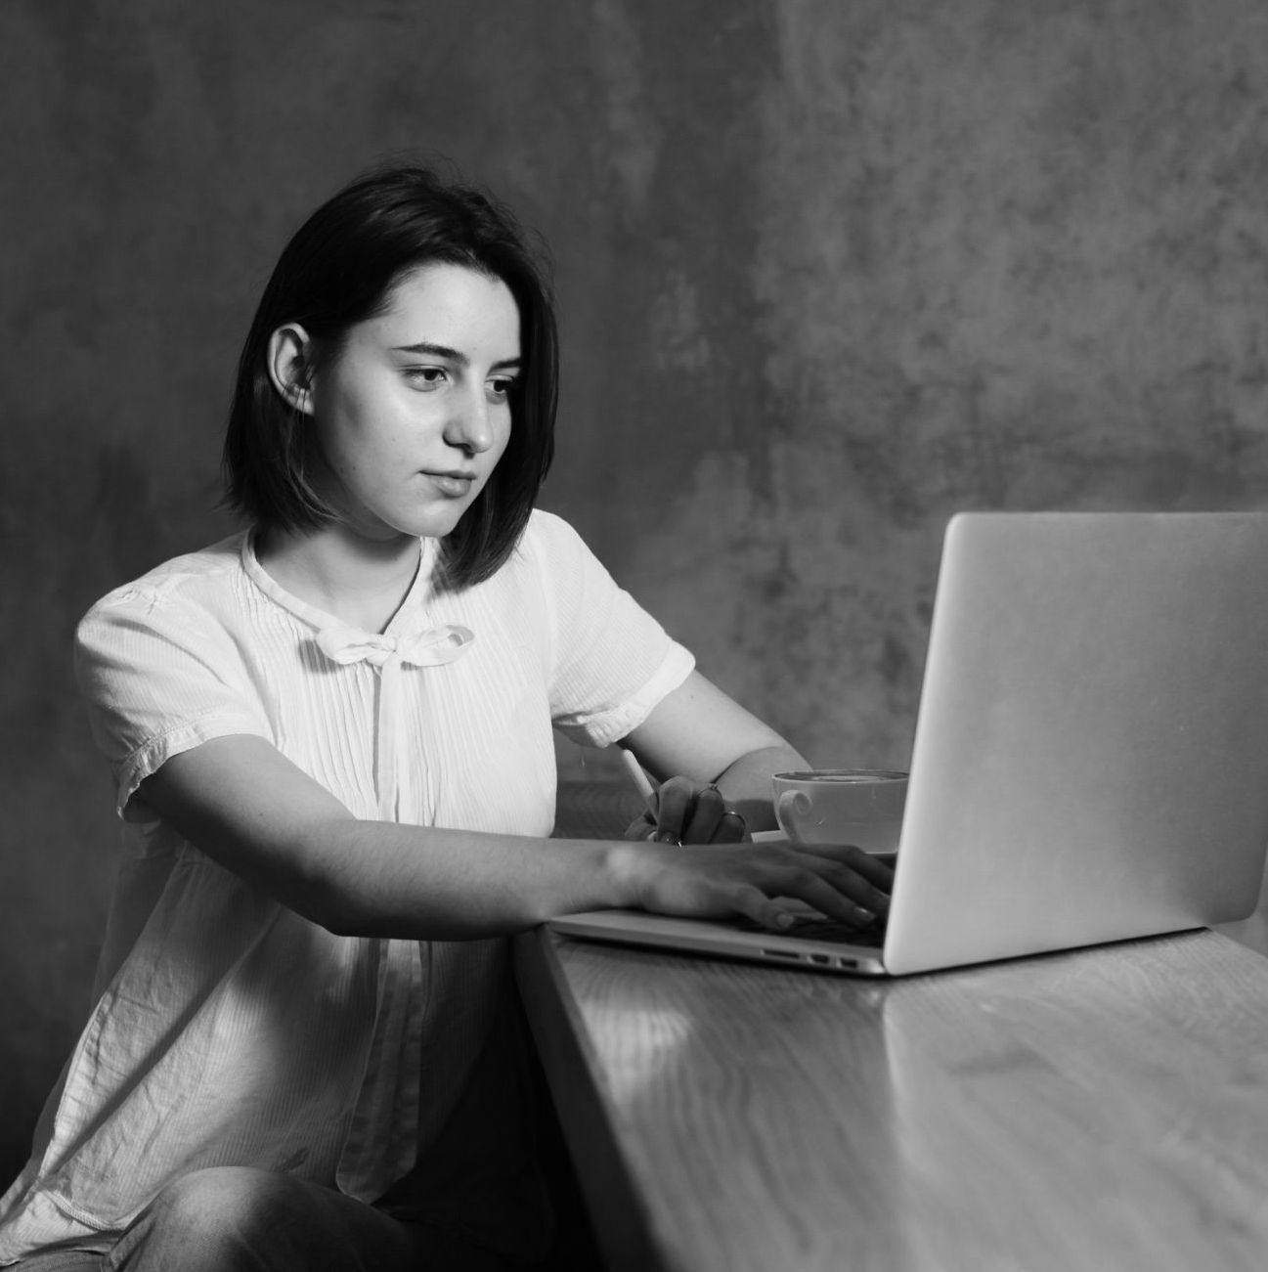
Other part-painting methods
1
2
Generative Adversarial Networks
Inpainting and Outpainting
3
Generative Image Inpainting with Auxiliary Contextual Reconstruction
8
Image-to-Image Translation
4
7
Parallel Multi-Resolution Fusion Network
Distillation-Guided Image Inpainting
6
5
Conditional Texture and Structure Dual Generation
Wavelet-based Generation Network
Notes:
Inpainting -> regiunea lipsa este mica si plasata in interiorul portiunii vazute -> problematica daca se doreste obtinerea detalii externe considerabile
Outpainting -> partea nedescoperita este mare -> problema este ca procedeul nu este antrenat sa foloseasca parti de intrare de forme diferite de cele de baza (in general, patratice)
AMBELE metode folosesc expansiunea regiunii prin marirea componentelor cunoscute, fapt ce aduce efecte negative atunci cand exista diferente remarcabile intre cele doua portiuni
GANs -> 2014 -> Goodfellow creeaza aceste GAN-uri care evolueaza in timp: StyleGAN - creste capacitatea celor initiale prin transferul de stil; GauGAN - foloseste distributia Gauss pentru a produce imagini realiste din simple schite; BigGAN - creaza imagini cu rezolutie si fidelitate inalta
Generative Image Inp with Aux Context -> metoda ia informatii doar din regiunile care confera detalii importante pentru partea lipsa, fapt ce aduce eficienta; aduce rezultate prin folosirea unei retele special create numita PatchGAN
Parallel -> foloseste abordari diferite pentru structura si textura: convolutie partiala a rezolutiei (are rol in eliminarea discrepantei dintre culori si partajarea informatiilor de la partile cunoscute la cele necunoscute) si fuziunea reprezentarilor utilizand masti (acest proces da rezultate deoarece se iau in calcul cazuri specifice pentru pixeli - cei care contin informatii esentiale si cei care se deseneaza dificil) -> poate fi utilizata si pentru forme regulate sau nu
Wavelet -> foloseste transformari de unda discreta, descompunand imaginea initiala in benzi de frecventa
Distillation -> module de atentie si transfer de cunostinte, precum si completare adaptiva de blocuri
Conditional Texture and Structure Dual Generation -> abordeaza diferit cele doua componente: folosesc modulul creat de ei Bi-GFF si CFA care au rolul de a combina textura obtinuta de decodificator si componentele structurale
I2I Translation -> Pix2Pix este un exemplu de aplicatie care primind o imagine, o translateaza, iar la final s edecide daca predictia facuta este sau nu plauzibila

Slide 15
THANKS!
Do you have any questions?

Slide 16
References
[1] Dongsheng Guo, Haoru Zhao, Yunhao Cheng, Haiyong Zheng, Zhaorui Gu, Bing Zheng, Underwater Vision Lab, Sanya Oceanographic Institution, “Painting from Part”, pp. 14779-14786, ICCV 2021
[2] James Vincent, “This AI art app is a glimpse at the future of synthetic media”, The Verge publication, 2021
[3] J Yunjey Choi, Youngjung Uh, Jaejun Yoo, Jung-Woo Ha, “StarGAN v2: Diverse image synthesis for multiple domains”, CVPR, pp. 8188–8197, 2020
[4] Gao Huang, Zhuang Liu, Laurens Van Der Maaten, Kilian Q Weinberger, “Densely connected convolutional networks”, CVPR, pp. 4700–4708, 2017
[5] Philip Isola, Jun-Yan Zhu, Tinghui Zhou, Alexei A Efros, “Image-toimage translation with conditional adversarial networks”, CVPR, pp. 1125–1134, 2017
[6] Guilin Liu, Fitsum A Reda, Kevin J Shih, Ting-Chun Wang, Andrew Tao, Bryan Catanzaro, “Image inpainting for ir- regular holes using partial convolutions”, ECCV, pp. 85–100, 2018
[7] Takeru Miyato, Toshiki Kataoka, Masanori Koyama, Yuichi Yoshida, “Spectral normalization for generative adversarial networks”, ICLR, pp. 73-82, 2018
[8] Yu Zheng, Zhe Lin, Huchuan Lu, Vishal M Patel, “CR-Fill: Generative Image Inpainting With Auxiliary Contextual Reconstruction”, ICCV, pp. 14164-14173, 2021
[9] Wentao Wang, Jianfu Zhang, Li Niu, Haoyu Ling, Xue Yang, Liqing Zhang, “Parallel Multi-Resolution Fusion Network for Image Inpainting”, ICCV, pp. 14559-14568, 2021
[10] Yingchen Yu, Fangneng Zhan, Shijian Lu, Jianxiong Pan, Feiying Ma, Xuansong Xie, Chunyan Miao, “WaveFill: A Wavelet-Based Generation Network for Image Inpainting”, ICCV, pp. 14114-14123, 2021
[11] Maitreya Suin, Kuldeep Purohit, A N Rajagopalan, “Distillation-Guided Image Inpainting”, ICCV, pp. 2481-2490, 2021
[12] Xiefan Guo, Hongyu Yang, Di Huang, “Image Inpainting via Conditional Texture and Structure Dual Generation”, ICCV, pp. 14134-14143, 2021

